Slide 1
Scheduling of students activities for optimum academic performance
Group:
Fadi El Bejjani
Anthony Farhat
Alexandre Megarbane
Advisor:
Dr. Jean Saade - EECE
Notes:
Reminder: First speaker should introduce group members.
Reduce the amount of text used in the slides.
Recommended to use graphs, images, charts, videos, audio (multimedia in general) (but be careful from overuse).

Slide 2
Motivation & Desired Needs
10 most common time-management mistakes are due to ineffective scheduling and prioritizing tasks → Negative effects on the overall student performance and GPA.
Output: Efficient schedule of work study activities.

Slide 3
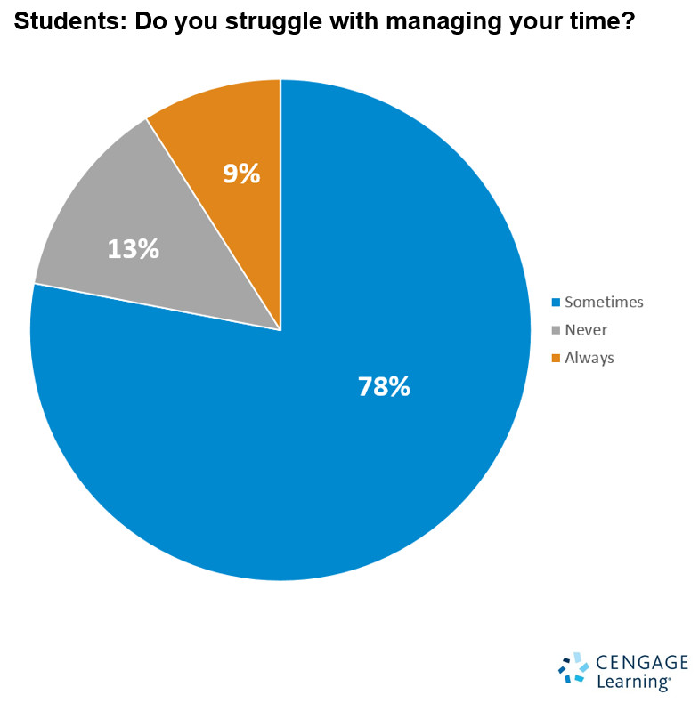

Slide 4
User Requirements
Enter the different courses
Enter the difficulty for each course
Enter the tasks
Enter the tasks' length
Enter the dates and time of extracurricular activities
Enter the number of study hours per week
Enter the target grade for each course
Output: detailed schedule

Slide 5
System requirements
Monitor the student's progress (compare performance to expected values)
The course difficulty should be expressed in percentage
The number of study hours per week should be calculated using the fuzzy logic sets of rules

Slide 6
Deliverables
Android application - Inputs: tasks (courses, exams/assignments/projects with deadlines)
Output: Intelligent time organization for students (study hours, study hours per course, study schedule)

Slide 7
Technical Constraints
Inputs can be modified → application updates schedule correctly
Scheduling in real-time
Application size <= 50MB
RAM usage <= 200MB

Slide 8
Non-Technical Constraints
User-friendly.
Easy-to-use.
Must be completed in 9 months.

Slide 9
Literature Review
Neural Networks
Fuzzy Logic
Getrevising

Slide 10
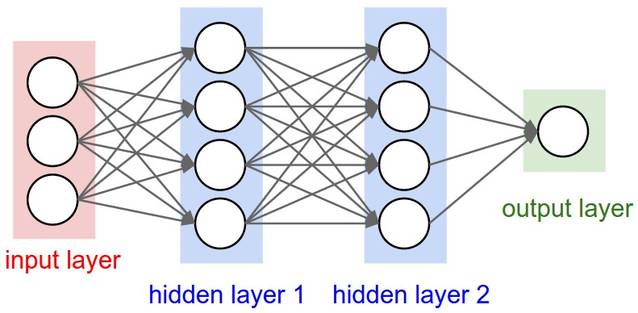
Neural Networks
Patterned after operations of neurons in human brain
Backpropagation
Pros and Cons

Slide 11
Fuzzy Logic
Pros
Good if lots of uncertainty and variability
Doesn’t need a lot of data to train
Cons
Not useful in well defined models
Doesn’t scale to large problems

Slide 12
Getrevising
Web based application for student study plan
Pros:
Realistic
Detailed and Flexible
Cons:
Prone to errors
Not intelligent

Slide 13
Proposed Solution Methodology
What is time management? Where and how is it applicable?
Inputs/Outputs of a scheduling application
Possible algorithms that can be used
Design alternatives
Developing – Testing - Maintaining

Slide 14
Overall Design Alternatives
User interface:
Mobile application | Web based application
Offline database | Online database
Risk of losing data | No risk of losing data
Small screen size | Bigger screen size
Connection to the internet is not needed | Connection to the internet is a must

Slide 15
Why fuzzy logic ?
Approximate inputs rather than precise ones
Does not require precise inputs
Rule based: number of rules is dependent on the number of inputs and outputs
Rules can be tweaked
Linguistic: ease of translation of human rules into fuzzy rules

Slide 16
Fuzzy logic
Inputs:
Target grade
Course difficulty
Free time available

Slide 17
Fuzzy logic: first alternative
One Fuzzy Region One Rule
If x is A and x is B and x is C, then x is D
A: The fuzzy set of high grades
B: The fuzzy set of difficult courses
C: The fuzzy set of a lot of free time
D: The fuzzy set of a lot of study hours

Slide 18
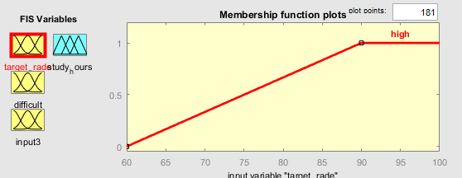
Fuzzy logic: first alternative
y = 1
y = (1/30) * x - 2

Slide 19
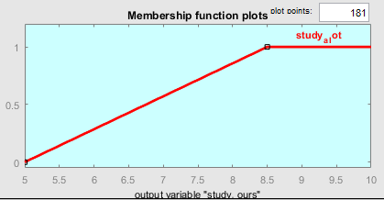
Fuzzy logic: first alternative
Output Fuzzy Set:
Input x₀ from X. The output D’ will have the following membership function:
𝜇𝐷′= (𝜇𝐴(𝑥0) ∧ 𝜇𝐵(𝑥0) ∧ 𝜇𝐶(𝑥0)) ∧ 𝜇𝐷(𝑦)
Sample output: Target grade: 85 -> 𝜇A = 0.833 Difficulty: 60% -> 𝜇B = 0.8 Free time: 7h -> 𝜇C = 0.571
Thus, (𝜇𝐴(𝑥0) ∧ 𝜇𝐵(𝑥0) ∧ 𝜇𝐶(𝑥0)) = 0.571 𝜇𝐷′= 0.571 ∧ 𝜇𝐷(𝑦)

Slide 20
Fuzzy logic: second alternative
Many Regions Many Rules
The variables are partitioned into linguistic labels that represent many states for each input, giving a good account for the decision-making process

Slide 21
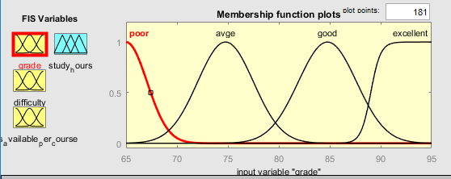
Fuzzy logic: second alternative

Slide 22
Design Iterations
Two approaches for the grades input:
Target GPA
GPA= (c₁*g₁+c₂*g₂+…c_{n}*g_{n}) / (c₁+c₂+…+c_{n})
c₁…c_{n} is the number of credits per course and g₁…g_{n} is the target grade per course
Grades per course

Slide 23
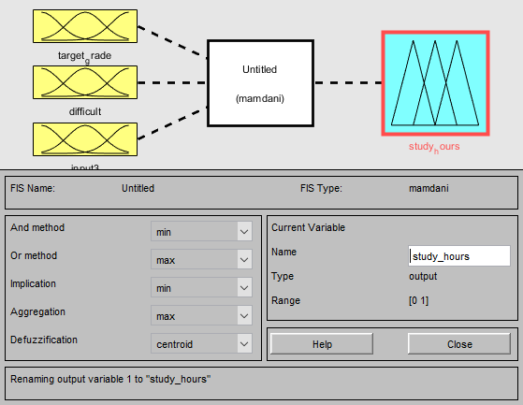
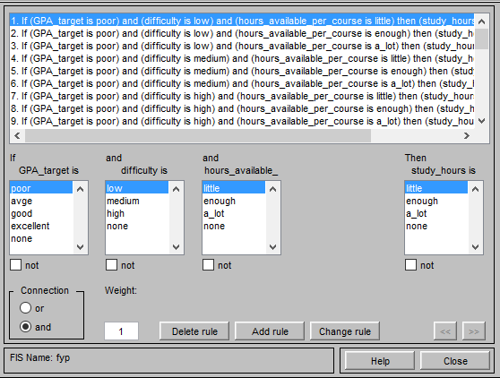
Preliminary Implementation

Slide 24
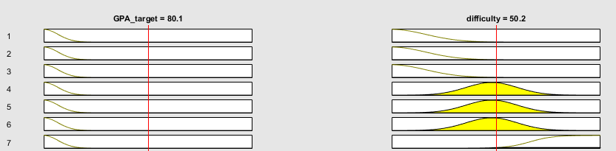
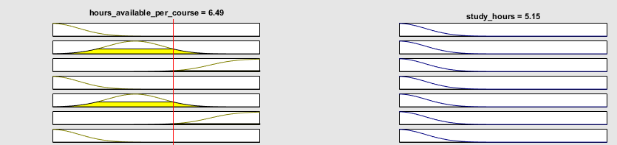
Preliminary Testing

Slide 25
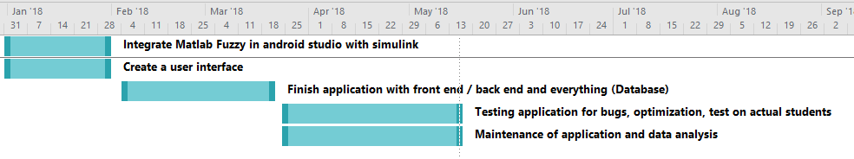
Spring Plan and Schedule

Slide 26
Acknowledgments
We thank the committee for their attention and especially Dr. Jean Saade for guiding us through this semester.

Slide 27
Questions?

